Slide 1
CHAPTER 3
Crystal
and
Amorphous Structure
in Materials

Slide 2
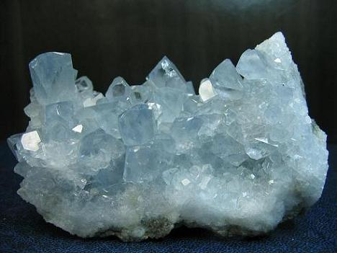
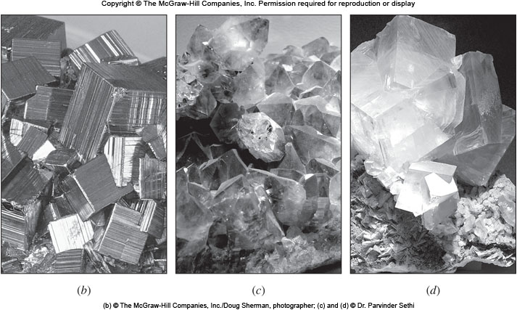
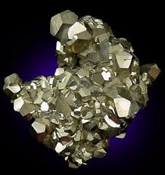
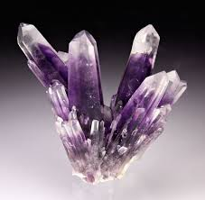
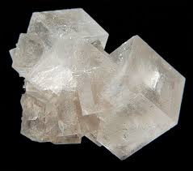
Crystalline Shapes
Celestite SrSO₄
天青石
Pyrite FeS₂
黃鐵礦愚人金
Amethyst SiO₂
紫水晶
Halite NaCl 岩鹽

Slide 3
The Space Lattice
Atoms, arranged in repetitive 3-Dimensional pattern, in long range order (LRO) give rise to crystal structure. Such as: metals, some ceramics or polymers.
Materials arranged in short range order only are called amorphous materials (noncrystalline). 非晶 Such as: some ceramics or most polymers.
Properties of solids depends upon structure and bonding force.
An imaginary network of lines, with atoms at intersection of lines, representing the arrangement of atoms is called space lattice.空間格子
Each lattice point has identical surroundings.

Slide 4
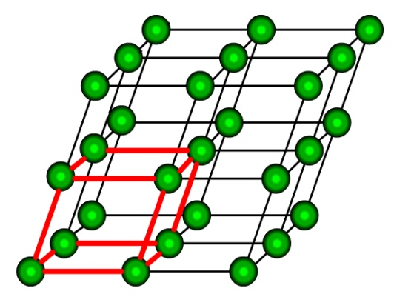
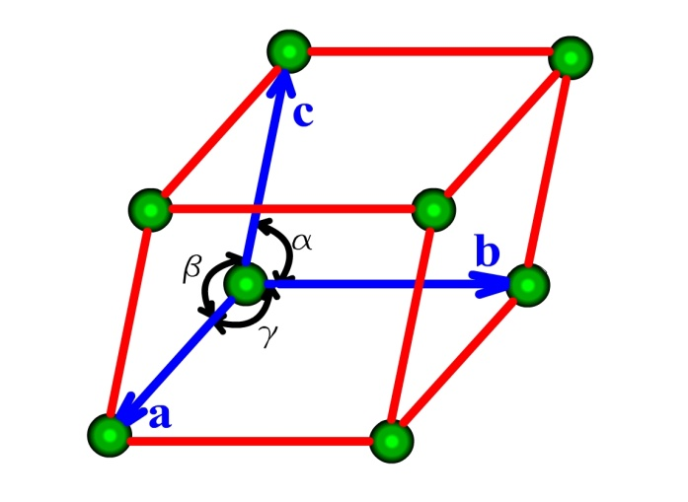
Unit cell
Unit cell is that block of atoms which repeats itself to form space lattice and is the smallest subdivision of the lattice.
The atoms do not necessarily coincide with lattice points.
Lattice constants: a, b, c; α, β, γ.
Space Lattice
Unit Cell

Slide 5
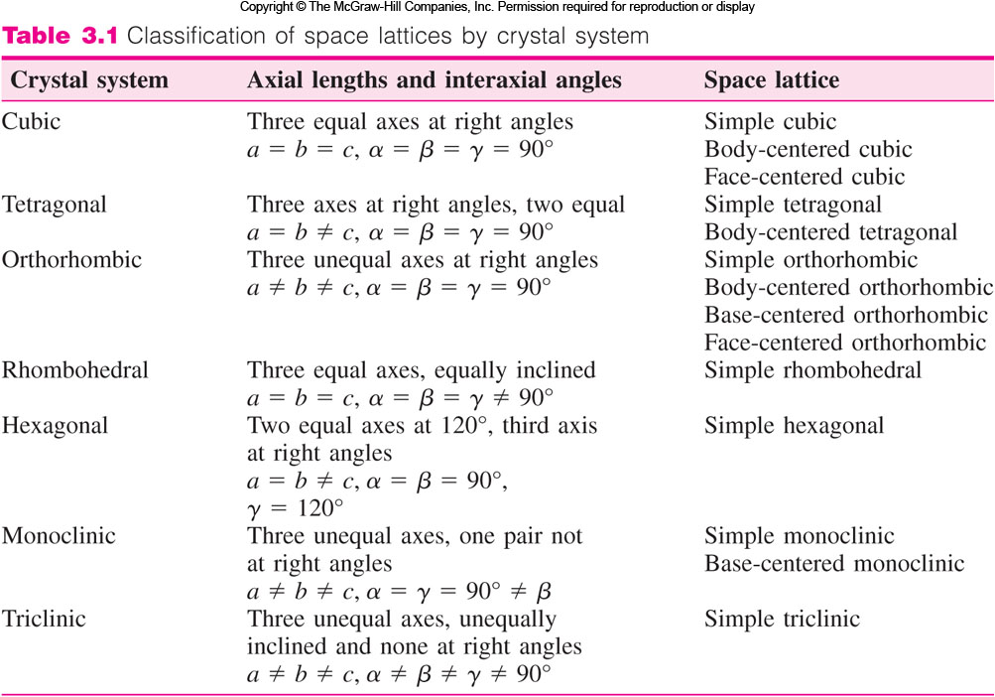
Crystal Systems and Bravais Lattice
Bravais (1811-1863): 14 UC
5
立方體
4
正方體
3
斜方體
6
菱方體
7
六方體
2
單斜體
1
三斜體

Slide 6
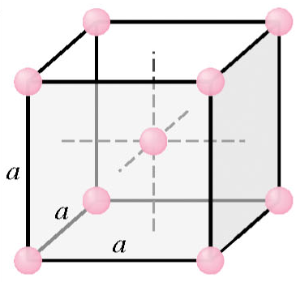
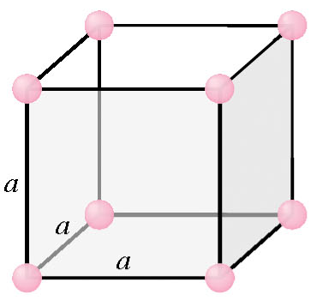
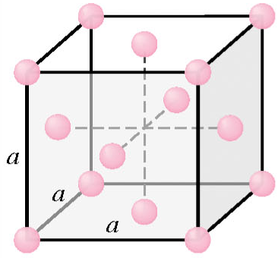
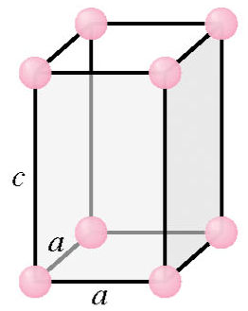
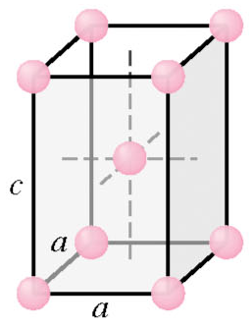
Types of Unit Cells
Cubic Unit Cell
a = b = c
α = β = γ = 90°
Tetragonal
a = b ≠ c
α = β = γ = 90°
Simple
Body Centered
Face centered
Figure 3.2
Simple
Body Centered

Slide 7
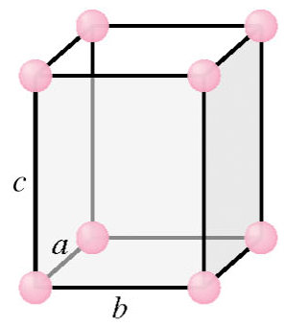
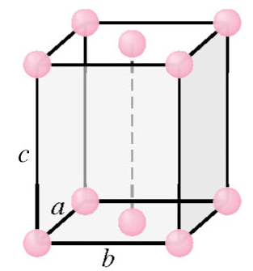
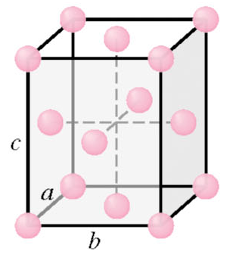
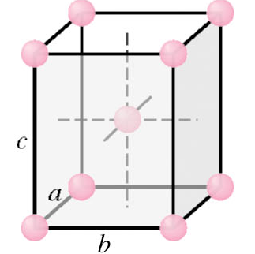
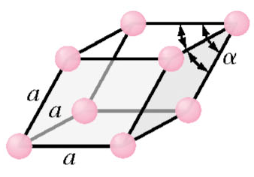
Types of Unit Cells (Cont..)
Orthorhombic
a ≠ b ≠ c
α = β = γ = 90°
Rhombohedral
a = b = c
α = β = γ ≠ 90°
Simple
Base Centered
Body Centered
Face Centered
Figure 3.2
Simple

Slide 8
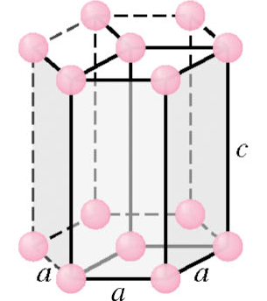
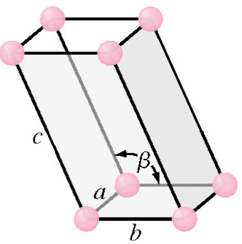
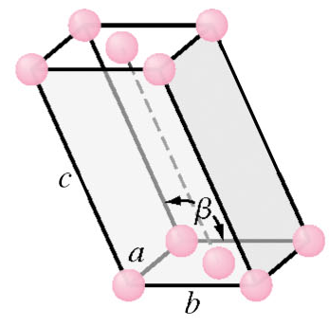
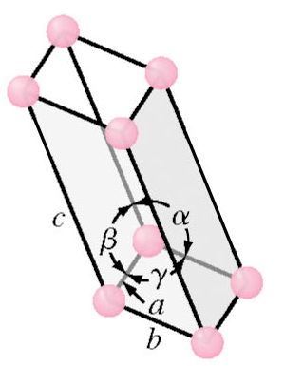
Types of Unit Cells (Cont..)
Hexagonal
a = b ≠ c
α = β = 90°, γ = 120°
Monoclinic
a ≠ b ≠ c
α = γ = 90° ≠ β
Triclinic
a ≠ b ≠ c
α ≠ β ≠ γ ≠ 90°
Simple
90°
90°
c
c
Base
Centered
b
b
a
Simple
a
Figure 3.2
Simple

Slide 9
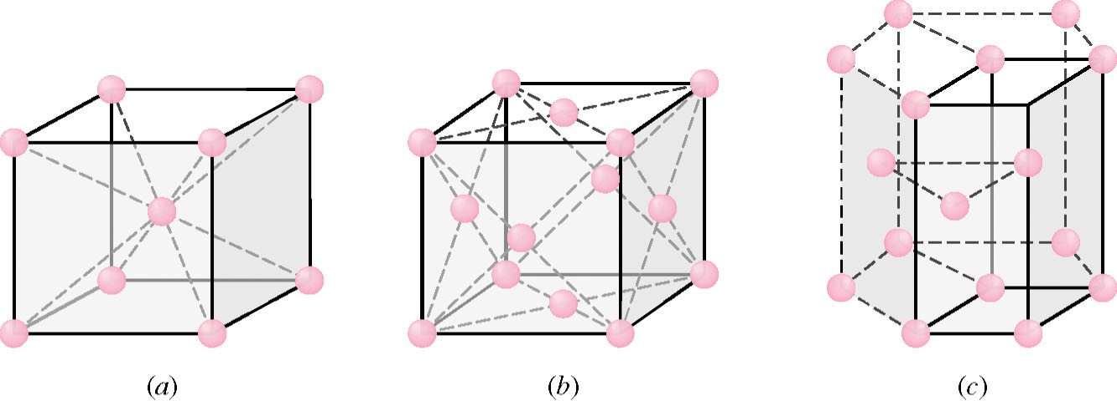
Principal Metallic Crystal Structures
90% of the metals have either Body Centered Cubic (BCC), Face Centered Cubic (FCC) or Hexagonal Close Packed (HCP) crystal structures. HCP is the densest version of simple hexagonal crystal structure.
The densely packed structure are in lower and more stable energy arrangements.
BCC Structure
FCC Structure
HCP Structure

Slide 10
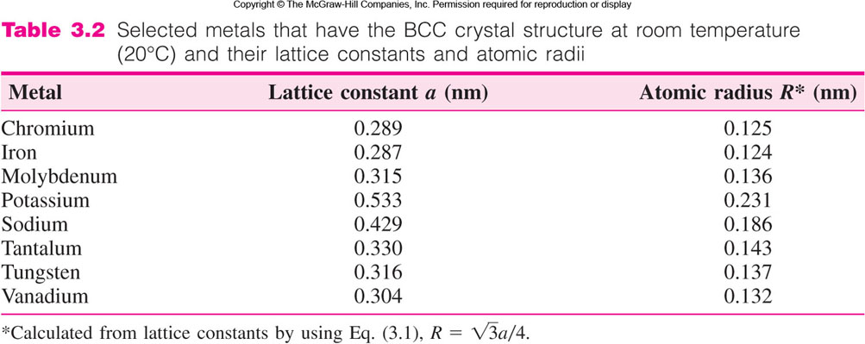
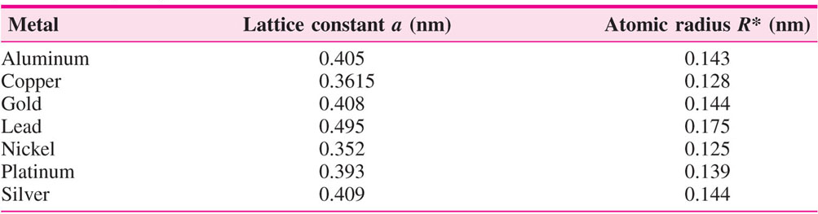
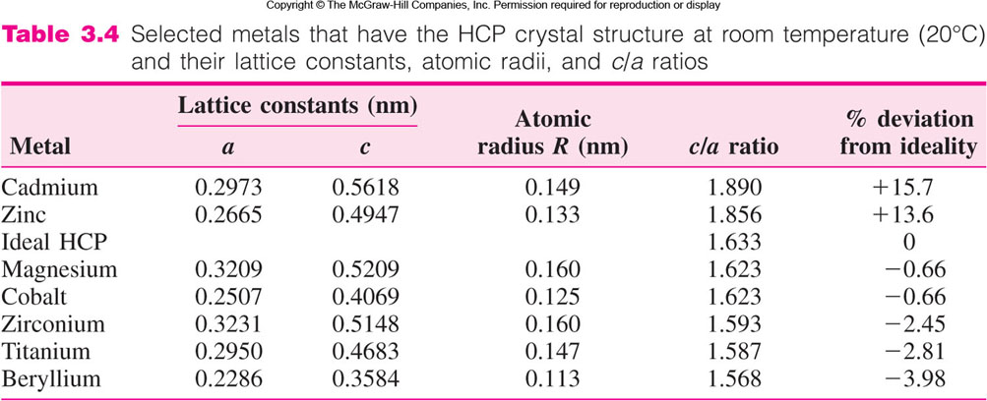
BCC
FCC
HCP

Slide 11
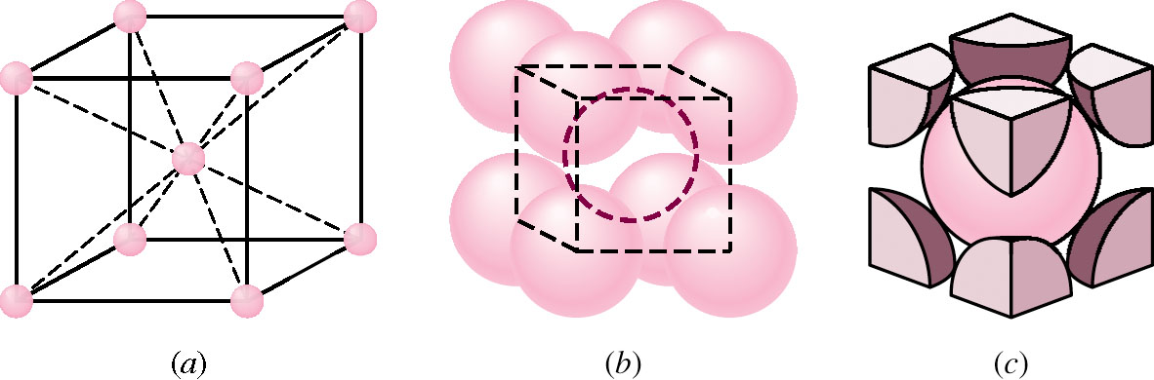
BCC Crystal Structure
Represented as one atom at each corner of cube and one at the center of cube.
Each atom has 8 nearest neighbors.
Therefore, coordination number is 8.
Examples:
Chromium (a = 0.289 nm, r = 0.125 nm)
Iron (a = 0.287 nm, r = 0.124 nm)
Sodium (a = 0.429 nm, r = 0.186 nm)
配位數

Slide 12
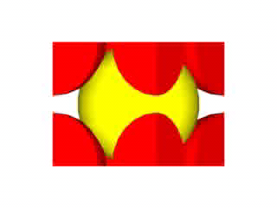
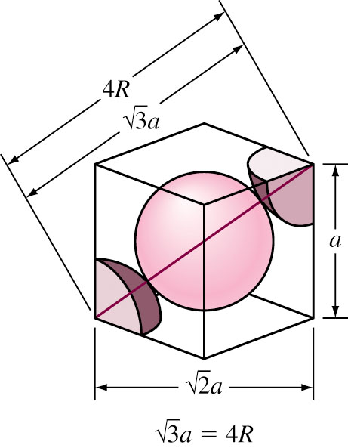
BCC Crystal Structure (Cont..)
Each unit cell has eight 1/8 atom at corners and 1 full atom at the center.
Therefore each unit cell has
Atoms contact each
other at cube diagonal
(8 × 1/8 ) + 1 = 2 atoms
Therefore, a =

Slide 13
Atomic Packing Factor of BCC Structure
Volume of atoms in unit cell
Atomic Packing Factor =
Volume of unit cell
V_{atoms} = = 8.373 R³
V _{unit cell} = a³ =
= 12.32 R³
8.723 R³
Therefore, APF =
= 0.68
12.32 R³

Slide 14
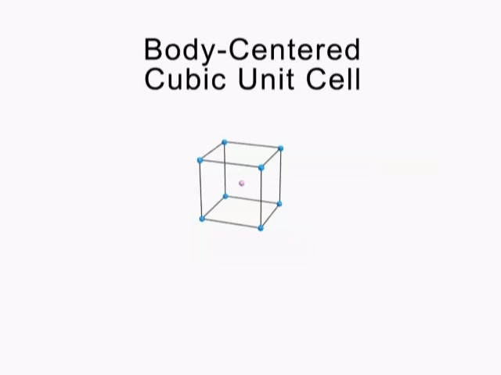
Body Centered Structure-Summary
Animation

Slide 15
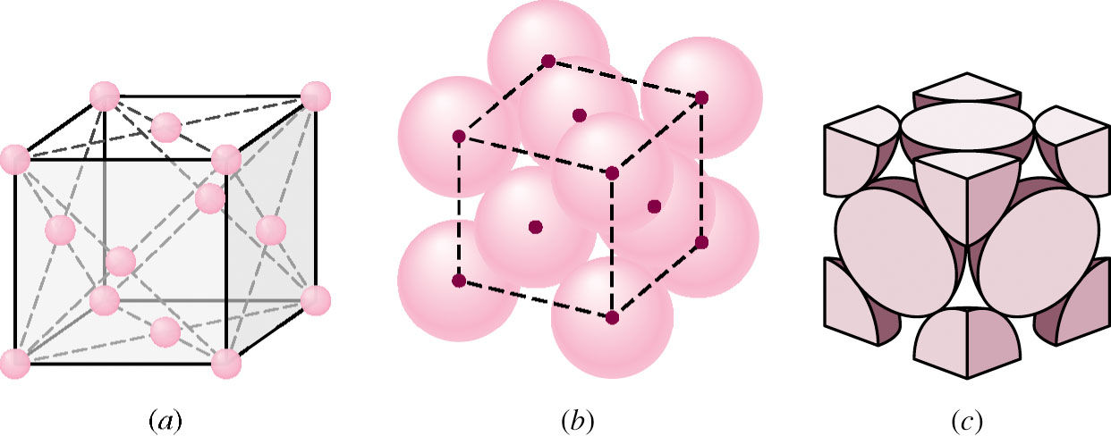
FCC Crystal Structure
FCC structure is represented as one atom each at the corner of cube and at the center of each cube face.
Coordination number for FCC structure is 12
Atomic Packing Factor is 0.74
Examples:
Aluminum (a = 0.405 nm, r = 0.143 nm)
Gold (a = 0.408 nm, r = 0.144 nm)

Slide 16
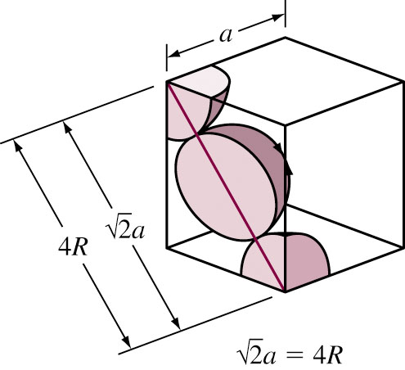
FCC Crystal Structure (Cont..)
Each unit cell has eight 1/8 atom at corners and six ½ atoms at the center of six
faces.
Therefore each unit cell has
Atoms contact each other across cubic face diagonal
(8 × 1/8) + (6 × ½) = 4 atoms
Therefore, lattice constant a =

Slide 17
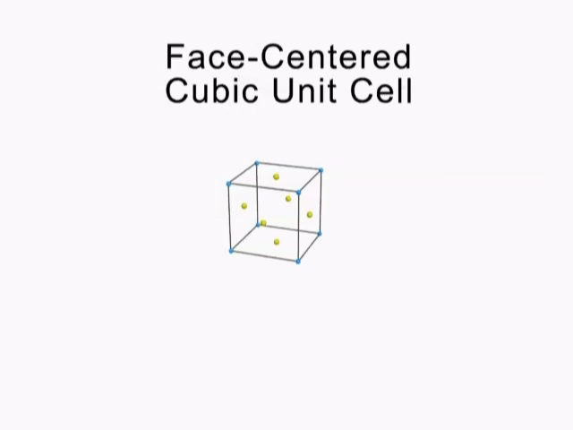
Face Centered Crystal Structure
Animation

Slide 18
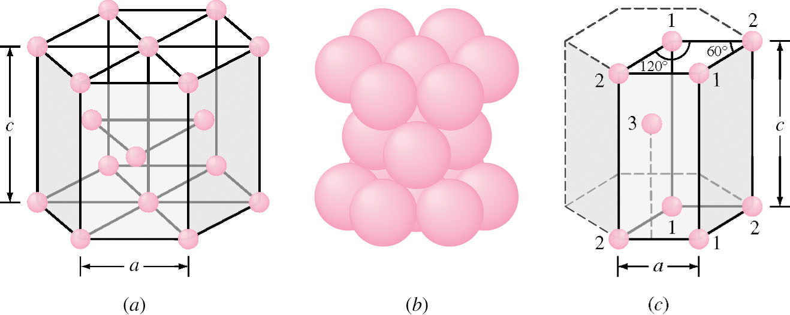
Hexagonal Close-Packed Structure
The HCP structure is represented as an atom at each of 12 corners of a hexagonal prism, 2 atoms at top and bottom face and 3 atoms in between top and bottom face.
Atoms attain higher APF by attaining HCP structure than simple hexagonal structure.
The coordination number is 12, APF = 0.74.
Large cell
Large cell
Isolated unit cell

Slide 19
HCP Crystal Structure (Cont..)
Each atom has six 1/6 atoms at each of top and bottom layer, two half atoms at top and bottom layer and 3 full atoms at the middle layer.
Therefore each HCP unit cell has
Examples:
Zinc (a = 0.2665 nm, c = 0.4947, c/a = 1.85, r = 0.133 nm)
Cobalt (a = 0.2507 nm, c = 0.4069, c/a = 1.62, r = 0.125 nm)
Ideal c/a ratio is 1.633.
(2 × 6 × 1/6) + (2 × ½) + 3 = 6 atoms

Slide 20
BCC
FCC
HCP

Slide 21
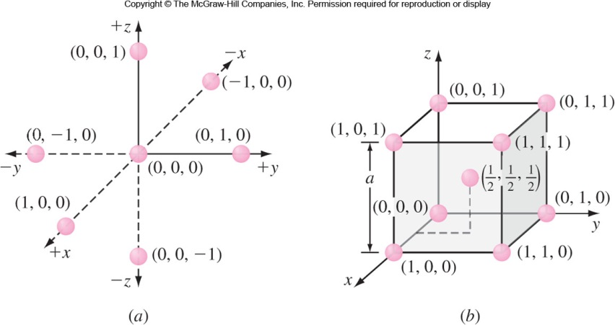
Atom Positions in Cubic Unit Cells
Cartesian coordinate system is use to locate atoms.
In a cubic unit cell
y axis is the direction to the right.
x axis is the direction coming out of the paper.
z axis is the direction towards top.
Negative directions are to the opposite of positive directions.
Atom positions are located using unit distances along the axes.

Slide 22
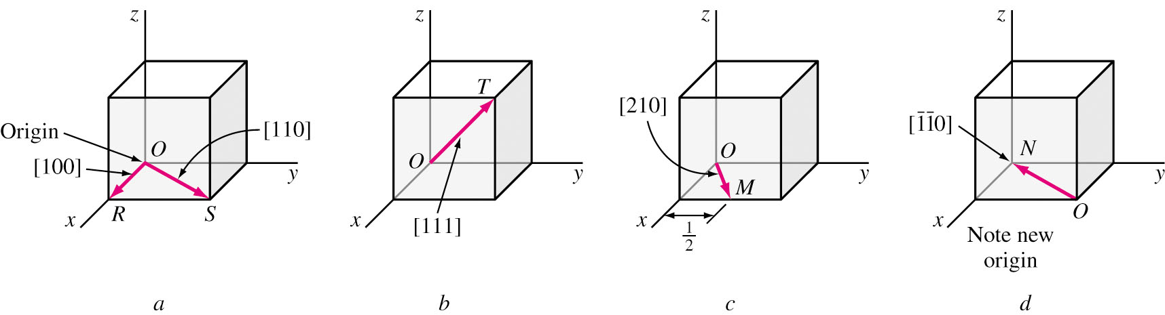
Directions in Cubic Unit Cells
In cubic crystals, Direction Indices are vector components of directions resolved along each axes, resolved to smallest integers.
Direction indices are position coordinates of unit cell where the direction vector emerges from cell surface, converted to integers.

Slide 23
Procedure to Find Direction Indices
Produce the direction vector till it
emerges from surface of cubic cell
z
(1,1/2,1) − (0,0,0)
= (1,1/2,1)
(1,1/2,1)
Determine the coordinates of point
of emergence and origin
y
(0,0,0)
2 × (1,1/2,1)
= (2,1,2)
Subtract coordinates of point of
emergence by that of origin
x
The direction indices are [212]
NO
Convert them to
smallest possible
integer by multiplying
by an integer.
Are all are
integers?
YES
Are any of the direction
vectors negative?
NO
YES
Represent the indices in a square
bracket without comas with a
over negative index (e.g.: [121])
Represent the indices in a square
bracket without comas (e.g.: [212] )

Slide 24
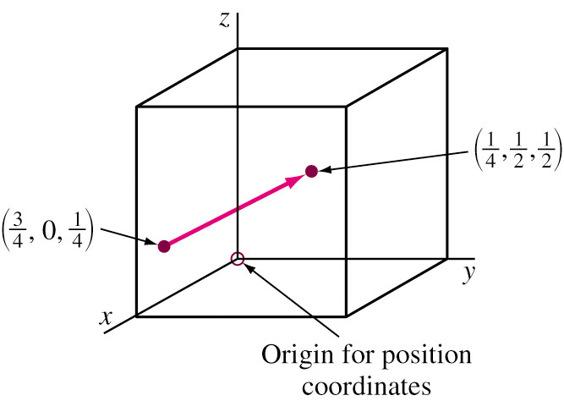
Direction Indices - Example
Determine direction indices of the given vector. Origin coordinates are (3/4 , 0 , 1/4). Emergence coordinates are (1/4, 1/2, 1/2). Subtracting origin coordinates from emergence coordinates,
(1/4, 1/2, 1/2) − (3/4 , 0 , 1/4)
= (−1/2, 1/2, 1/4)
Multiply by 4 to convert all
fractions to integers
4 × (−1/2, 1/2, 1/4) = (−2, 2, 1)
Therefore, the direction indices are

Slide 25
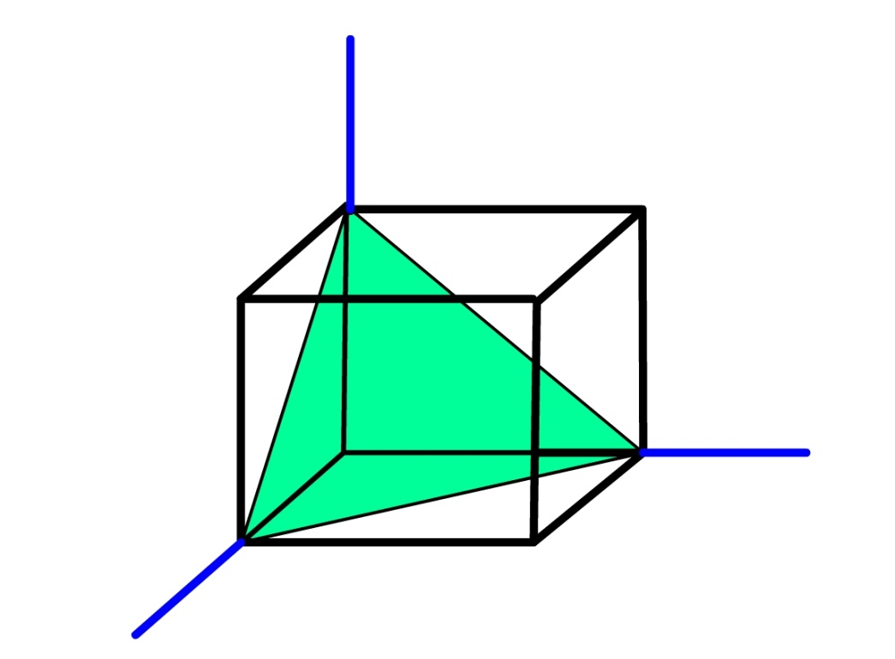
Miller Indices
Miller Indices are used to refer to specific lattice planes of atoms.
They are reciprocals of the fractional intercepts (with fractions cleared) that the plane makes with the crystallographic x, y and z axes of three nonparallel edges of the cubic unit cell.
z
Miller Indices = (111)
y
x

Slide 26
Miller Indices - Procedure
Choose a plane that does not pass
through origin
Determine the x, y and z intercepts
of the plane
Find the reciprocals of the intercepts
Fractions?
Clear fractions by
multiplying by an integer
to determine smallest set
of whole numbers
Yes
Place a ‘bar’ over the
Negative indices
Enclose in parenthesis (hkl) where h,k,l
are miller indices of cubic crystal plane for x, y and z axes. e.g.: (111)

Slide 27
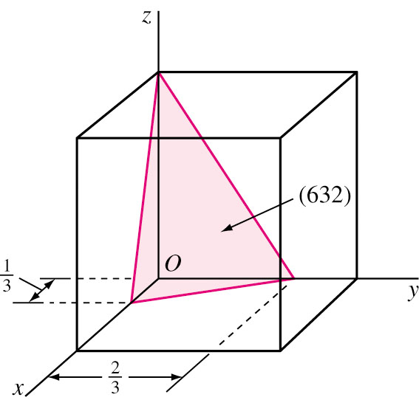
Miller Indices - Examples
z
Intercepts of the plane at x, y & z axes are 1, ∞ and ∞
Taking reciprocals we get (1, 0, 0).
Miller indices are (100).
*******************
Intercepts are 1/3, 2/3 & 1.
Taking reciprocals we get (3, 3/2, 1).
Multiplying by 2 to clear fractions, we get (6, 3, 2).
Miller indices are (632).
(100)
y
x

Slide 28
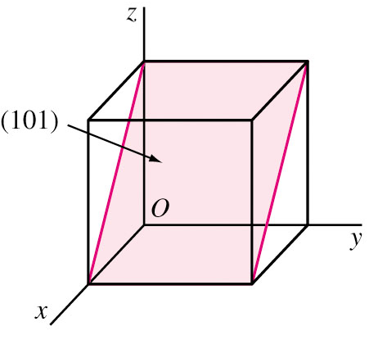
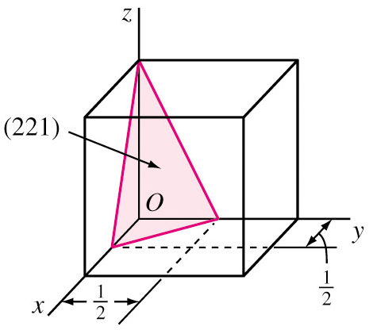
Miller Indices – Examples (Cont..)
Plot the plane (101)
Taking reciprocals of the indices we get (1 ∞ 1).
The intercepts of the plane are x = 1, y = ∞ (parallel to y) and z = 1.
******************************
Plot the plane (2 2 1)
Taking reciprocals of the indices we get (½, ½, 1).
The intercepts of the plane are x = 1/2, y = 1/2 and z = 1.
Figure EP3.7 a
Figure EP3.7 c

Slide 29
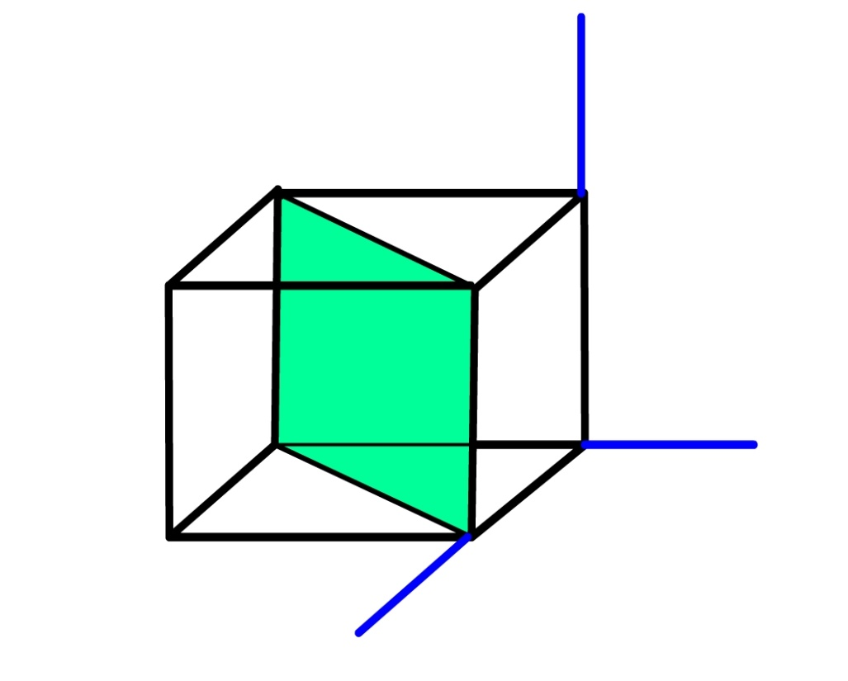
Miller Indices – Example (Cont..)
Plot the plane
The reciprocals are (1, −1, ∞)
The intercepts are x = 1, y = −1 and z = ∞ (parallel to z axis)
To show this plane in a
single unit cell, the
origin is moved along
the positive direction
of y axis by 1 unit.
(110)
z
y
x
Figure EP3.7 b

Slide 30
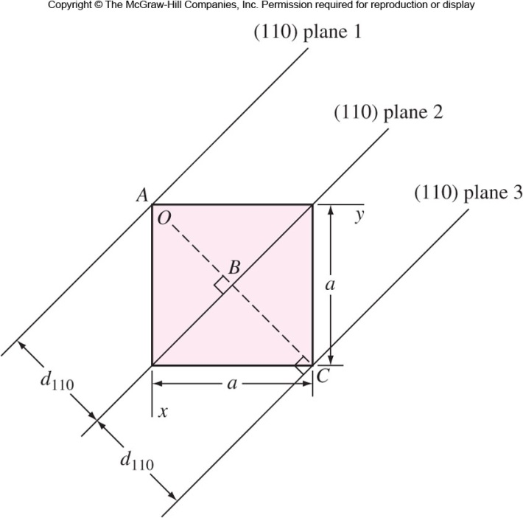

Miller Indices – Important Relationship
Direction indices of a direction perpendicular to a crystal plane are same as Miller indices of the plane.
Interplanar spacing between parallel closest planes with same Miller indices is given by
(110)
(010)
[110]
[010]
Fig. 3.13 Top view of cubic unit cell showing the distance between (110) crystal planes, d₁₁₀.

Slide 31
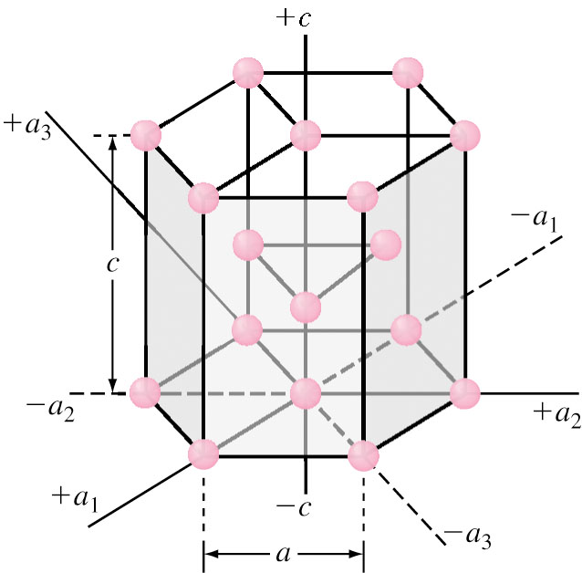
Planes and Directions in Hexagonal Unit Cells
Four indices are used (hkil) called as Miller-Bravais indices.
Four axes are used (a₁, a₂, a₃ and c). Unit cell vs. Large cell.
Reciprocal of the intercepts that a crystal plane makes with the a₁, a₂, a₃ and c axes give the h, k, i and l indices respectively.

Slide 32
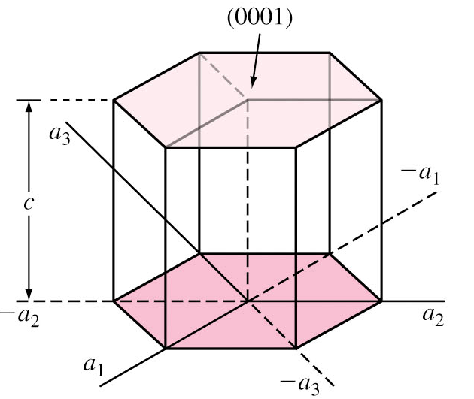
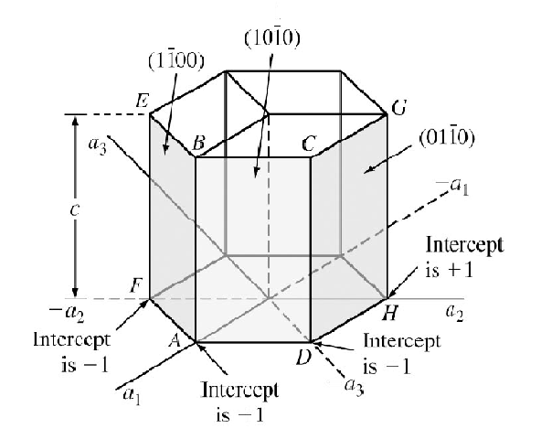

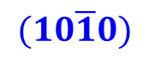
Hexagonal Unit Cell - Examples
Basal Planes: Intercepts a₁ = ∞ a₂ = ∞ a₃ = ∞ c = 1 (hkil) = (0001)
Prism Planes: For plane ABCD Intercepts a₁ = 1 a₂ = ∞ a₃ = −1 c = ∞ (hkil) =
Figure 3.15 a&b
$$(10\overline{1}0)$$
+1

Slide 33
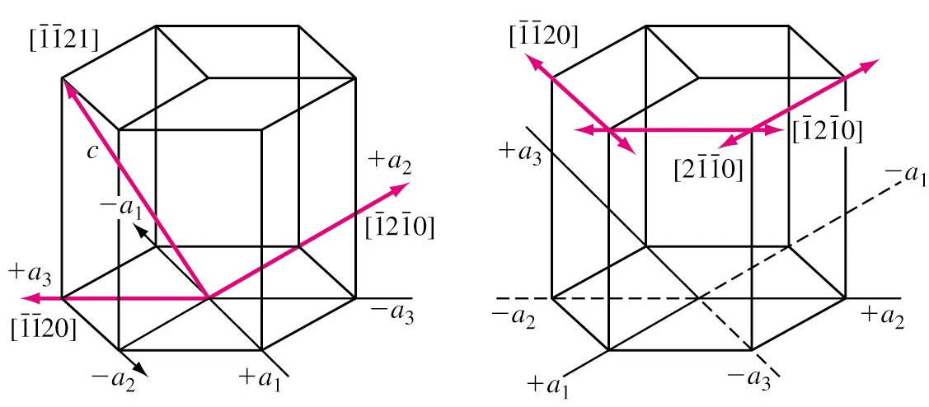
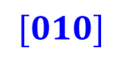
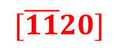




Directions in HCP Unit Cells
Indicated by 4 indices [uvtw].
u, v, t and w are lattice vectors in a₁, a₂, a₃ and c directions respectively. u + v + t = 0
Example: For a₁, a₂, a₃ directions, the direction indices are
[ 2 1 1 0], [1 2 1 0] and [ 1 1 2 0] respectively.
$$[\overline{11}20]$$
+a₃
−a₁
$$[\overline{11}0]$$
+2a₃
−a₂
−a₁
+a₂
−a₂
$$[\overline{1}2\overline{1}0]$$
$$[010]$$
+a₁
−a₃
$$[100]$$
$$[2\overline{11}0]$$

Slide 34
Directions in HCP Unit Cells (Cont..)
c

Slide 35

Comparison of FCC and HCP crystals
Both FCC and HCP are close packed and have APF 0.74.
FCC crystal is close packed in (111) plane while HCP is close packed in (0001) plane.
FCC
HCP

Slide 36




Structural Difference between HCP and FCC
Plane A
Consider a layer
of atoms (Plane ‘A’)
‘b’ void
‘c’ void
Another layer (plane ‘B’)
of atoms is placed in ‘b’
Void of plane ‘A’
Plane A
Plane B
‘b’ void
‘c’ void
‘a’ void
Third layer of Atoms placed
in ‘a’ Voids of plane ‘B’. (Identical
to plane ‘A’.) HCP crystal.
Third layer of Atoms placed
in ‘c’ voids of plane ‘B’. Resulting
In 3rd Plane C. FCC crystal.
Plane A
Plane A
Plane B
Plane B
Plane A
Plane C
HCP(0001): ABABABABAB…..
FCC(111): ABCABCABC…..

Slide 37

BCC Crystal Structure
The BCC structure is not a close-packed structure and does not have close-packed planes like {111} in FCC.
BCC does have close-packed direction along the cube diagonals, which are the <111> directions..
Fig. 3.19 BCC crystal structure showing (a) the (100) plane and a section of the (110) plane.

Slide 38
Volume density of metal =
Example: Copper (FCC) has atomic mass of 63.54 g/mol and atomic radius of 0.1278 nm.
Volume Density
Mass/Unit cell
=
Volume/Unit cell
a=
=
= 0.361 nm
Volume of unit cell = V= a³ = (0.361nm)³ = 4.7 × 10⁻²⁹ m³
FCC unit cell has 4 atoms.
Mass of unit cell = m =
= 4.22 × 10⁻²⁸ Mg

Slide 39

Planar Atomic Density
Equivalent number of atoms whose
centers are intersected by selected area
Planar atomic density =
Example: In Iron (BCC, a = 0.287 nm), the (100) plane intersects center of 5 atoms (Four ¼ and 1 full atom).
Equivalent number of atoms = (4 × ¼ ) + 1 = 2 atoms Area of (110) plane =
=
Selected area
=
= 17.2 atoms/nm²
= 1.72 ×10¹³ atoms/mm²

Slide 40

Linear Atomic Density
Number of atomic diameters
intersected by selected length
of line in direction of interest
atomic density =
Example: For a FCC copper crystal (a = 0.361 nm), the [110] direction intersects 2 half diameters and 1 full diameter.
Therefore, it intersects ½ + ½ + 1 = 2 atomic diameters.
Length of line =
Linear atomic density =
=
Selected length of line

Slide 41
Polymorphism or Allotropy
Metals exist in more than one crystalline form. This is caller polymorphism or allotropy.
Temperature and pressure leads to change in crystalline forms.
Example: Iron exists in both BCC and FCC form
depending on the temperature.
Liquid
Iron
−273 °C
912 °C
1394 °C
1539 °C
α Iron
BCC
γ Iron
FCC
δ Iron
BCC

Slide 42

Allotropy Crystalline forms of Metals
Low temperature: FCC or HCP.
High temperature: BCC.

Slide 43

Crystal Structure Analysis
Information about crystal structure are obtained using X-Rays.
The X-rays used are about the same wavelength (0.05-0.25 nm) as distance between crystal lattice planes.
35 KV
+
−
(Eg:
Molybdenum)
(Mo, Cu)
~ 35 kV

Slide 44


X-Ray Spectrum of Molybdenum
X-Ray spectrum of Molybdenum is obtained when Molybdenum is used as target metal.
K_{α} and K_{β} are characteristic of an element.
For Molybdenum K_{α} occurs at wave length of about 0.07 nm.
Electrons of n = 1 shell of target metal are knocked out by bombarding electrons.
Electrons of higher level drop down by releasing energy to replace lost electrons
48

Slide 45

X-Ray Diffraction
Crystal planes of target metal act as mirrors reflecting X-ray beam.
If rays leaving a set of planes are out of phase (as in case of arbitrary angle of incidence no reinforced beam produced.
If rays leaving are in phase, reinforced beams are produced.
Out of phase: no reinforced beam
In phase: have reinforced beam

Slide 46

X-Ray Diffraction (Cont..)
For rays reflected from different planes to be in phase, the extra distance traveled by a ray should be a integral multiple of wave length λ .
nλ = MP + PN (n = 1, 2… order of diffraction) If d_{hkl} is interplanar distance, then MP = PN = d_{hkl}⋅sin θ
Therefore, λ = 2d_{hkl}⋅sin θ
d_{hkl}
After A.G. Guy and J.J. Hren, “Elements of Physical Metallurgy,” 3d ed., Addison-Wesley, 1974, p.201.)

Slide 47

X-Ray Diffractometer
With X-radiation shields removed.

Slide 48

X-Ray Diffraction Analysis
Powdered specimen is used for X-ray diffraction analysis as the random orientation facilitates different angle of incidence.
Radiation counter detects angle and intensity of diffracted beam.

Slide 49
Diffraction Condition for Cubic Cells
For BCC structure, diffraction occurs only on planes whose miller indices when added together total to an even number.
i.e. (h + k + l) = even Reflections present
(h + k + l) = odd Reflections absent
For FCC structure, diffraction occurs only on planes whose miller indices are either all even or all odd.
i.e. (h,k,l) all even Reflections present
(h,k,l) all odd Reflections present (h,k,l) not all even or all odd Reflections absent.

Slide 50


Diffraction Pattern of Tungsten
nλ = 2d sin θ → λ = 2d sin θ
有 110 peak 必有 220 peak
λ = 2d₂₂₀ sin 87°
d₁₁₀ = 2 d₂₂₀ ∴ 2λ = 2d₁₁₀ sin 87°

Slide 51

Diffraction Pattern of Aluminum
Ref.: 劉國雄等，工程材料科學，全華圖書，2008，p. 85.

Slide 52

Diffracting Planes for FCC and BCC
Simple Cubic

Slide 53
Interpreting Diffraction Data
We know that
Since
Substituting for d,
Therefore
Note that the wavelength λ and lattice constant a are the same for both incoming and outgoing radiation.

Slide 54
Interpreting Diffraction Data (Cont..)
For planes ‘A’ and ‘B’ we get two equations
(For plane ‘A’)
(For plane ‘B’)
Dividing each other, we get

Slide 55
BCC or FCC
For BCC crystals, the first two sets of diffracting planes are {110} and {200} planes.
Therefore
For FCC crystals the first two sets of diffracting planes are {111} and {200} planes
Therefore

Slide 56
Crystal Structure of Unknown Metal
Unknown
metal
Crystallographic
Analysis
FCC
Crystal
Structure
BCC
Crystal
Structure

Slide 57
EP 3.16 An X-ray diffractometer recorder chart for an element that has either the BCC or the FCC crystal structure shows diffraction peaks at the following 2θ angles: 40, 58, 73, 86.8, 100.4 and 114.7. λ_{x-ray} = 0.154 nm. Determine the structure and a.

Slide 58
Amorphous Materials
A tendency to achieve a crystalline because that is the most stable and corresponding to the lowest energy level. However, some factors inhibit this tendency and the amorphous materials are formed..
Random spatial positions of atoms.
Polymers: Secondary bonds do not allow formation of parallel and tightly packed chains during solidification.
Polymers can be semicrystalline.
Glass is a ceramic made up of SiO₄⁴⁻ tetrahedron subunits – limited mobility.

Slide 59

Amorphous Materials (Cont..)
Fig. 3.29 (a) Long-range order in crystalline silica, (b) silica glass without long-range order, and (c) amorphous structure in polymers.
Rapid cooling of metals (10⁸ K/s) can give rise to amorphous structure (metallic glass, 78%Fe-9%Si-13%B).
Metallic glass has superior metallic properties: strength, corrosion resistance, magnetic properties….

Slide 60

Summary
Long-range atomic order → Crystal → Space lattice → Unit cell → 7 Crystal systems (14 Bravais unit cell)
Most of Metals: BCC, FCC, HCP.
Crystal directions: [uvw], [uvtw]; <uvw>, <uvtw>.
Crystal planes: (hkl), (hkil); {hkl}, {hkil}.
Volume, planar, and linear density of atoms in unit cells.
Close-packed directions: <111>_{BCC}, <110>_{FCC}, <$2\overline{11}0$>_{HCP}.
Close-packed planes: {111}_{FCC}, {0001}_{HCP}.
Allotropic (Fe): α-BCC — 912 °C — γ-FCC — 1394 °C — δ-BCC — 1539 °C — l
X-ray diffraction: nλ = 2d sin θ (Bragg’s law)

